Slide 1
Web Real Time Communication
Srikrishna S, Pointel Solutions India

Slide 2
Core of WebRTC is Peer to Peer Communication not Browser to Browser Communication
Peer to Peer communication can do Media Sharing, arbitrary data transport
Srikrishna S, Pointel Solutions India

Slide 3
WebRTC Media Sharing is Just Like
A Skype with out Skype software
  You need skype software installed in your OS to use Skype
A Google talk with Google talk plugin
  Like Skype you need Gtalk plugins for browser and OS
A Google hang out with out Google Talk service
  Heart of Google Hang out is Gtalk
Facebook Video chat with out Skype Service
  After the Google hangouts, Facebook starts using Skype for Video Chat Service
Srikrishna S, Pointel Solutions India

Slide 4
So why WebRTC. not Others…?
Plugin free Peer to Peer communication
  Defferent plugins for defferent OS and browsers
Royalty-free Media Sharing
  Open source codes Audio : Opus Video : VP8
Easy to Develop Audio And Video Chating to WebSites
  All data transmission is take cared by WebRTC,Ultra low latency
Easy to Deploy Audio and Video Chating to WebSites
  Just Embed the JavaScript, No infrastructure need
HTML 5 API for Audio and Video Chat Integration to WebSites
  Build into the web browser
Srikrishna S, Pointel Solutions India

Slide 5
Why WebRTC Now…?
The good about WebRTC
1,000,000,000+ End points
May replace telephone communication
Supports mobile phone browsers as well
http://webrtcstats.com/webrtcs-bright-future/
Huge benefit for Contact Centers
  Can integrate with execting technoloy like sip,voip
Srikrishna S, Pointel Solutions India

Slide 6
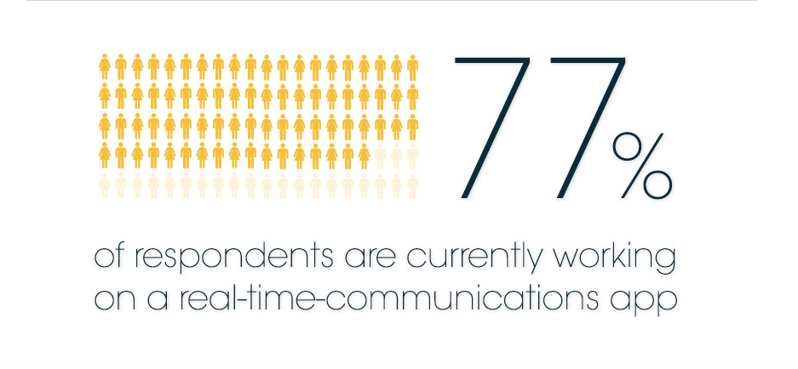

Slide 7
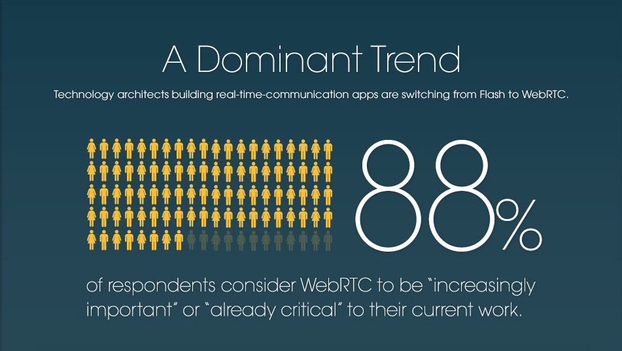

Slide 8
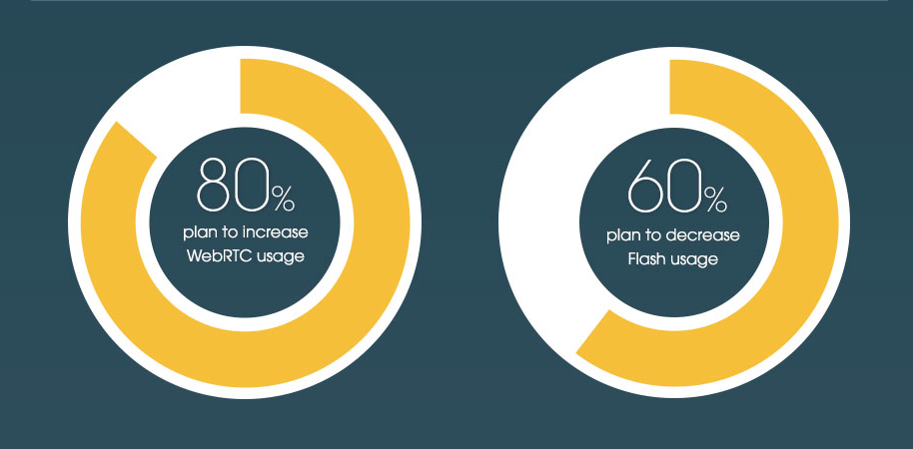

Slide 9
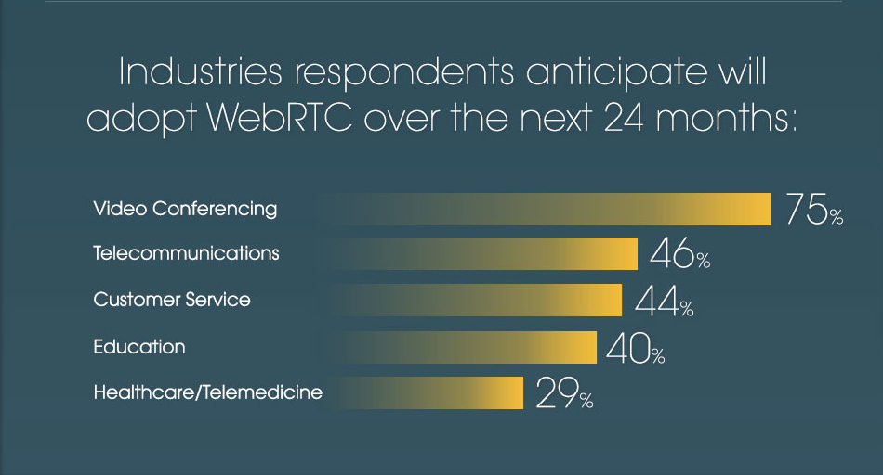

Slide 10
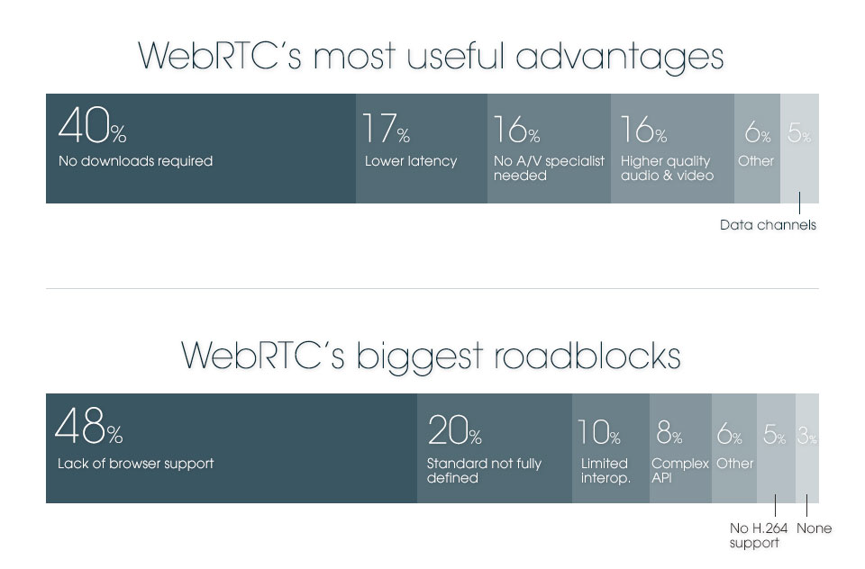

Slide 11
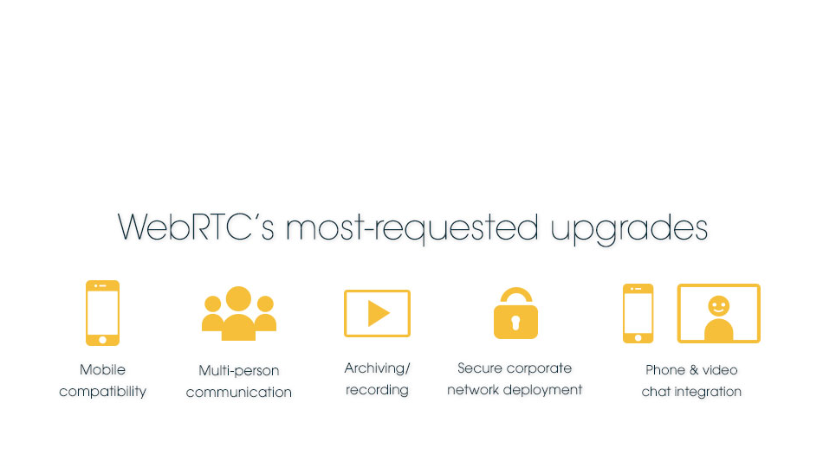

Slide 12
WebRTC implements three APIs:
MediaStream
RTCPeerConnection
RTCDataChannel
Srikrishna S, Pointel Solutions India

Slide 13
“ It all starts with getUserMedia() ”
MediaStream
getUserMedia() is a part of MediaStream API
It returns Microphone and Webcam output as a stream for sharing
getUserMedia() started its life lonely. Soon it is added to New MediaStream API Family
Srikrishna S, Pointel Solutions India

Slide 14
“ I can transport Anything U want ”
RTCPeerConnection
RTCPeerConnection is actualy responsible for handleing and transmiting all data in webrtc
  As well as finding shortest distance, conjuction control and connection establishment and everything related to network
It Directly handles the MediaStream from or to Communication channel
Srikrishna S, Pointel Solutions India

Slide 15
“All the arbitrary data to RTCPeerConnection must be given through me ”
RTCDataChannel
Abstracts the arbitrary data in a format for RTCPeerConnection
Gaming
Remote desktop applications
Real-time text chat
File transfer
Decentralized networks
Srikrishna S, Pointel Solutions India

Slide 16
Lets Just Dive Deeper…!
Srikrishna S, Pointel Solutions India

Slide 17
Non – Geek Intro to WebRTC Flow
Simple … ! It works Just like Torrents
First we need to get Local microphone and webcam for chat
We need to create an offer which is like invitation
Then some how we need to send that invitation to participant
If the participant accept’s our offer he will create an answer
That answer is some how sent back to us
Now both Paritcipants are agreed for a conversation
The Network information is exchanged some how between them
Once the network information is exchanged communication start’s
Srikrishna S, Pointel Solutions India

Slide 18
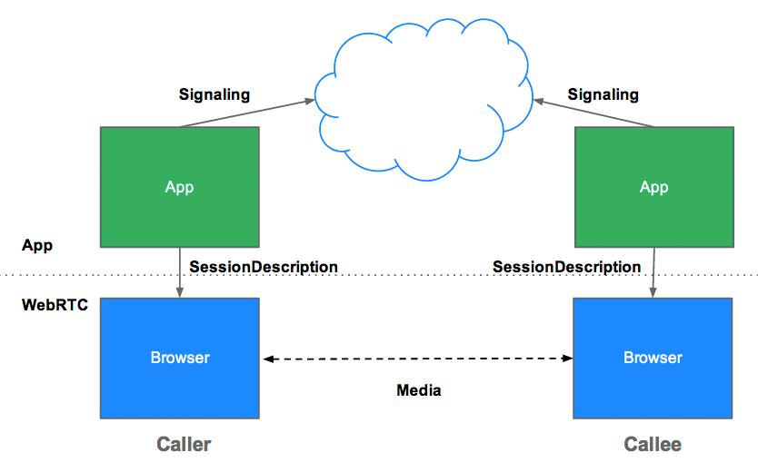

Slide 19
Peer to Peer so we Don’t need any servers right…?
May be for the following reasons :
User discovery and communication.
Signaling.
NAT/firewall traversal.
Relay servers in case peer-to-peer communication fails.
Srikrishna S, Pointel Solutions India

Slide 20
User discovery and communication
Srikrishna S, Pointel Solutions India

Slide 21
Signaling What is it…?
It is a machanism for Peer Discovery
It is a machanism for offer/answer between peers
It is a machanism for exchangeing the information between peers
Peers exchange data about media such as video format and resolution.
Session control messages used to open or close communication.
Error messages.
Srikrishna S, Pointel Solutions India

Slide 22
Do we need Infrastructure for Signaling ?
Ans is optional
You are not forced to use a Signaling Server
Signaling can be done via emails and mobile phone sms
Some times we need signaling Server based on requirements
WebRTC Spec says nothing about signaling
I told u right. Its just like torrents
Srikrishna S, Pointel Solutions India

Slide 23
How do we implement Signaling Server…?
Any Technology that can be used with Communcation between Server and client can be used for signaling.
WebSockets
  Node.js Apachi 7
XMLHttpRequest
Server-Sent Events
I told u right. Its just like torrents
Srikrishna S, Pointel Solutions India

Slide 24
NAT/firewall traversal
What is NAT
By now you know why nat/firewall traversal is need
How we are going to do nat/firewall traversal
  STUN AND TURN Servers
Stun Server for simple Nat traversal
Turn Server for Relay
Srikrishna S, Pointel Solutions India

Slide 25
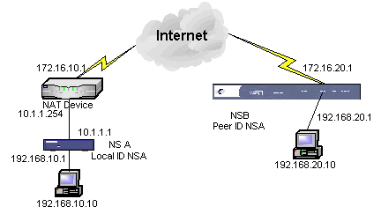

Slide 26
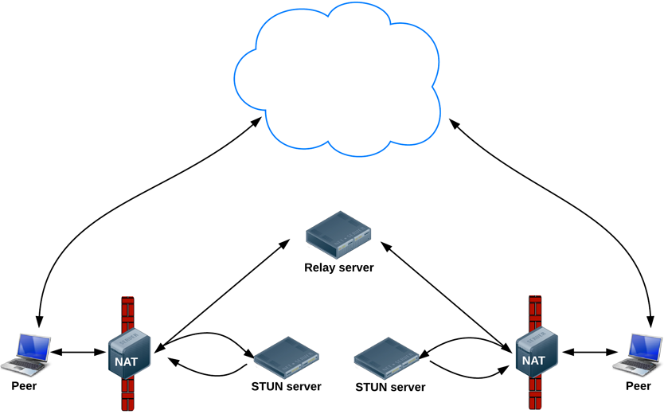

Slide 27
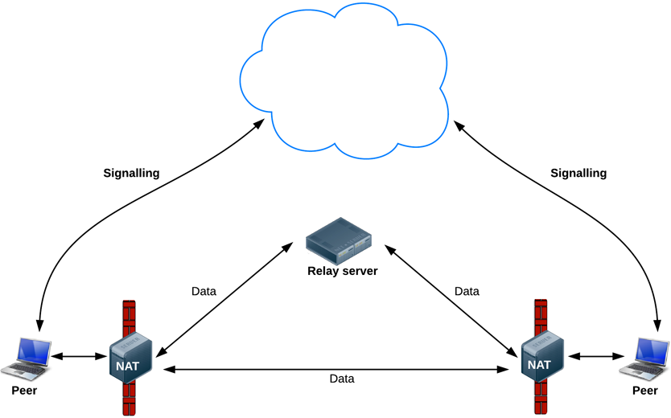

Slide 28
What about Multi Peer conference…?
Peer to Peer comunication is optimul for single peer to peer communication
For each aditional peer we need to create adition connection
Each aditional connection takes extra bandwidth
Srikrishna S, Pointel Solutions India

Slide 29
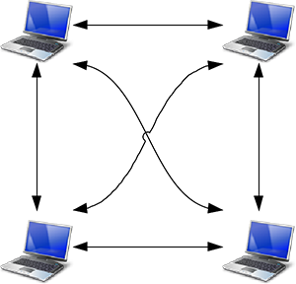
Mesh

Slide 30
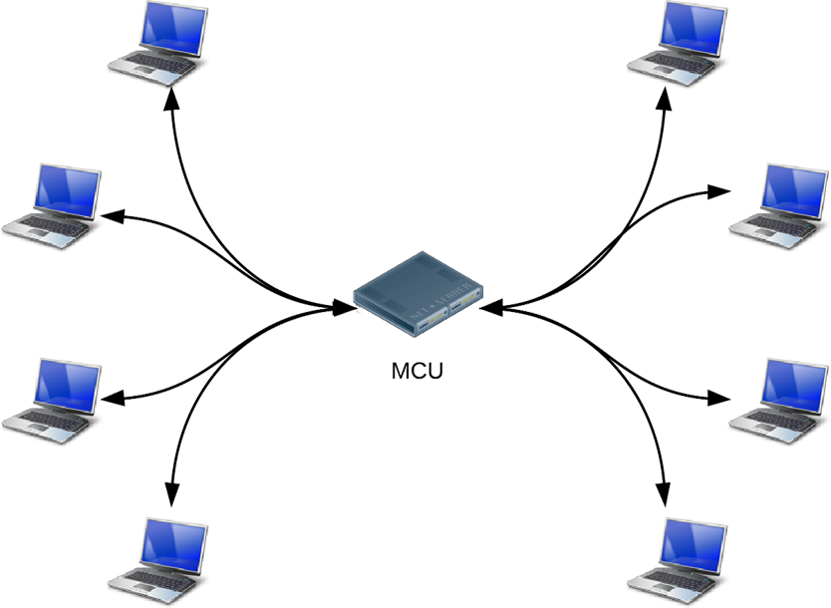
MCU

Slide 31
Finally For Tech-Geeks
navigator.getUserMedia({audio:true}, gotStream,failstream);
Var peer = new RTCPeerConnection(servers);
Peer.addStream(stream);
Peer.onicecandidate = function(event){}
Peer.onaddstream = function(event){}
Peer.createOffer(success(offer){},fail(err){});
Peer.createAnswer(success(answer){},fail(err){});
Peer.setLocalDescription(desc);
Peer.setRemoteDescription(desc);
Srikrishna S, Pointel Solutions India

Slide 32
The Bad About WebRTC
Specifications is not yet complete
Browser interoperability
Need latest browsers
Browser prefixed API
Not all Browsers supports WebRTC
Error Detection And Correction ( not network transmition errors )
Since it is peer to peer Meta data can only be tracked
Reliable and optimul for only one to one peer connection
It is JavaScript based so session state will be lost after refresh
Srikrishna S, Pointel Solutions India

Slide 33
“ if u have any questions then I have answers for U ”
I appreciate if u have any ?
Srikrishna S, Pointel Solutions India

Slide 34
Thank You ☺
Srikrishna S, Pointel Solutions India

